Slide 1



UbeR supply demand gap: case study
Arun antony

Slide 2
Problem statement
Analyze the Supply-Demand Problems on Uber data
Airport – City travel booking details over a period of time, are provided as input
Identify the burning issues, gap between supply and demand, root causes of the issues
Suggest recommendations to overcome the issues

Slide 3
Assumptions
The average values are estimated for analysis
Any trends due to any festivals/special occasions are not considered
Only details of Cancellation of trip by drivers, the Trips completed, Non availability of cabs with their timestamp were the only factors considered for analysis
Any behavioral characteristics of drivers or customers is not considered
Offers or introduction of new competitive players are not considered
Segmentation of hours used for analysis:
12 AM – 6 AM : Early Morning
6 AM – 4 PM : Daytime
4 PM – 8 PM : Evening
8 PM – 12 AM : Night Hours

Slide 4
methodology
Data Cleaning and Preparation
Identify the data quality issues and clean the data
Format date and time fields
Derive new variables needed for analysis
Data Exploration and Analysis
Analyze the data for different time slots
Identify type of requests and time slot that constitutes for supply-demand gap
Suggest Recommendations
Visualize and present the hypothesis of problem
Recommend ways to resolve the Supply-Demand gap

Slide 5
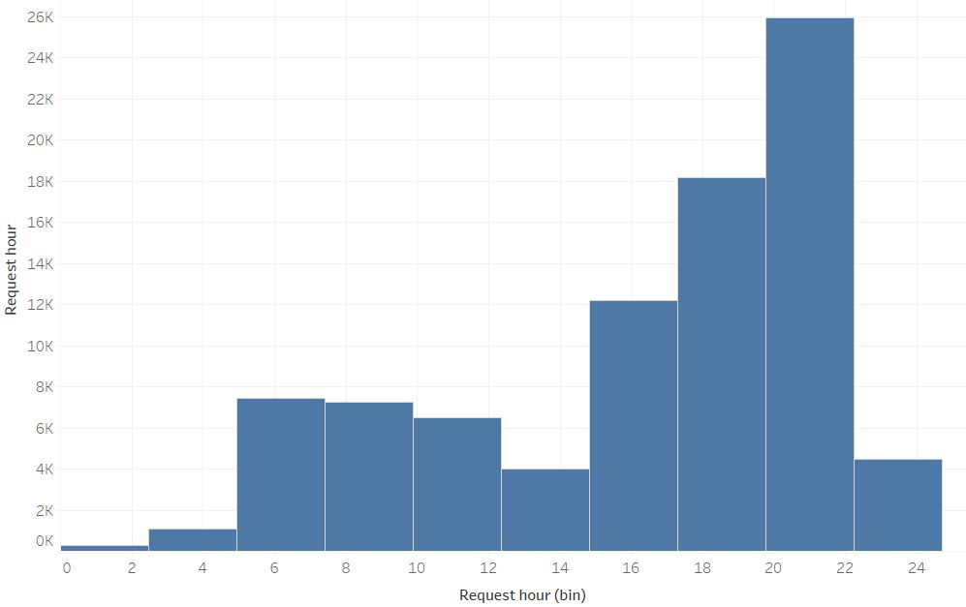
Demand variation throughout the day

Slide 6
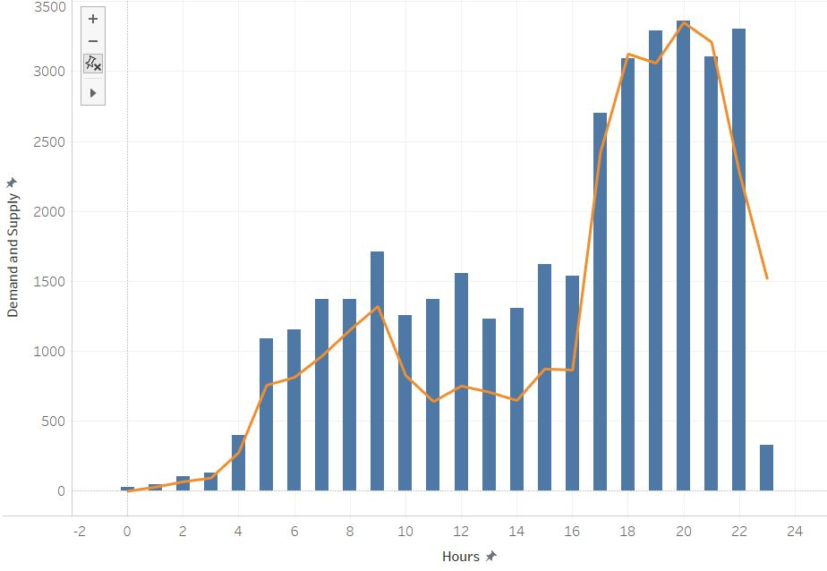
DeMAnd vs. Trips completed

Slide 7
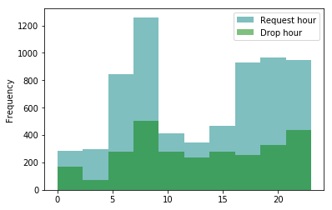
Overall demand supply gap

Slide 8
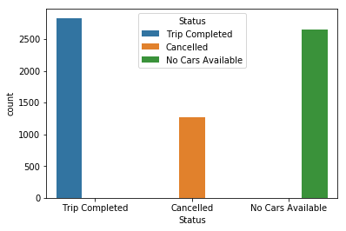
Comparison of Average STATUS of BOOKINGS
Non Availability of cabs is more severe concern than Cancellation

Slide 9
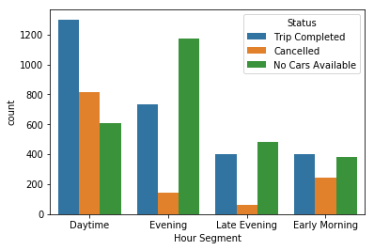
Analysis at different hour segments

Slide 10
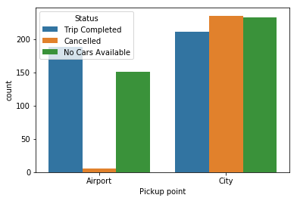
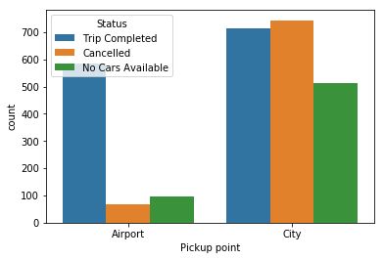
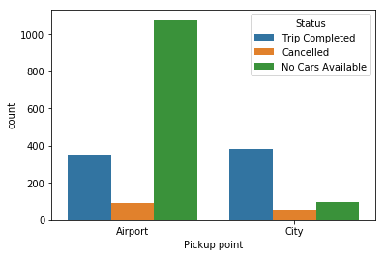
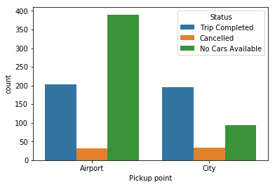
1. Early Morning hours
2. Daytime hours
3. Late Evening hours
4. Night hours

Slide 11
Supply demand gap analysis
City to Airport : During Early morning has the severe supply demand gap
Airport to City: During late evening and night hours has the severe supply demand gap
During late night and morning hours drivers tend to cancel majority of bookings from City to Airport
During afternoon and late evenings, the non-availability of cabs (more than 3x demand) from Airport to City is noticed from the trends

Slide 12
Reasons for Supply-Demand gap
Idle time on trips between Airport and City is high, which affects the earnings of drivers and it pushes the drivers to cancellation trips to and from Airport
Travel from city to airport and vice-versa is time consuming due to heavy traffic in cities during peak hours
Non availability of sufficient cars at peak hours

Slide 13
Recommendations !
Special incentives/allowances and penalties for cancellation above threshold during peak hours for airport trips must be provided
Incentives/credits for new drivers joining Uber can be provided
Refreshing hub for Drivers near Airport can be provided
Credits for waiting time between trips due to less demand to be provided
Special credits to Pre-Scheduled booking facility for customers
Provide a short term offer for customers like “50% off to Airport Trip this Month”

Slide 14
Thank You!

